Slide 1
SIAR SpaceAge Institute of Antiaging Research

Slide 2
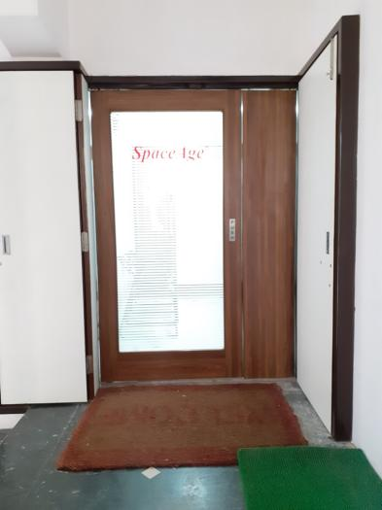
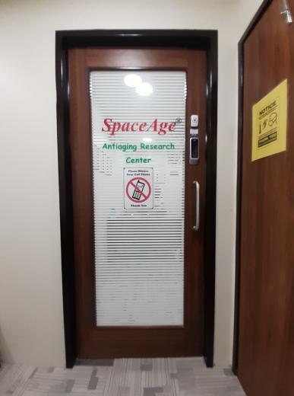
MAIN
ENTRANCE
RECEPTION
ENTRANCE

Slide 3
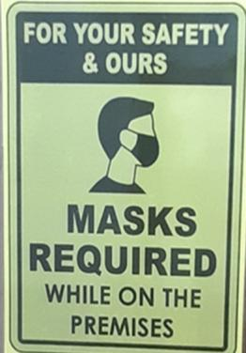
COVID – 19 SAFETY PROTOCOL

Slide 4
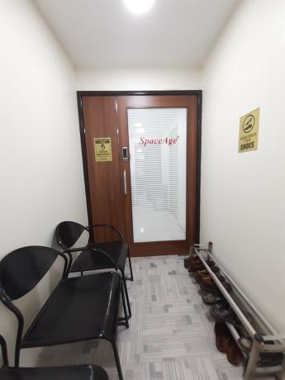
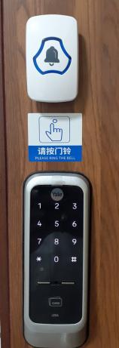
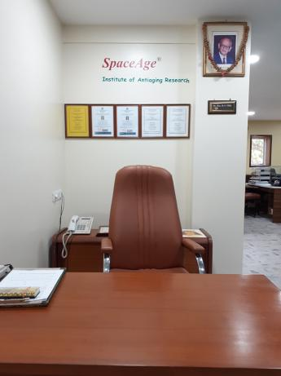
SECURITY SYSTEMS
WAITING LOBBY
RECEPTION AREA

Slide 5
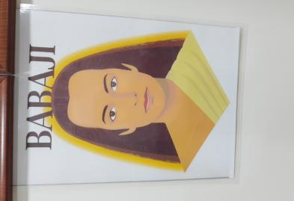
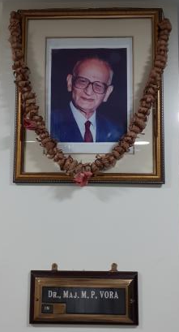
SPIRITUAL GUIDES

Slide 6
ENLIGHTENMENT

Slide 7
PERCEPTION

Slide 8
PHILOSOPHY OF MODERN MEDICINE

Slide 9
Superior doctors prevent the disease.
Mediocre doctors treat the disease before evident.
Inferior doctors treat the full-blown disease.
--- Huang Dee Nai-Chang ---
(2600 BC 1st Chinese Medical Text)
Let thy Food be thy medicine and thy medicine be thy food.
Hippocrates, Civca 400BC
“The doctor of the future will give no medicine, but will interest his patient in the care of the human frame, in Diet and the cause and prevention of disease.”
Thomas Edison

Slide 10
It is much more important to know what sort of patient has a disease than what sort of disease a patient has.
Sir William Osler
“Twenty five years in which I used (prescribed) drugs, and 33 year in which I have not (prescribed) drugs, should make any belief that drugs are unnecessary and in most cases injurious, worth something to those who care to know the truth.”
John H. Tilden, M.D.
1851 - 1940
“All disease, all discomfort is the result of an opinion, in essence, a lie individuals believe about themselves or their life. Find the lie for them, tell them the truth and you've given back their health. The truth is always the cure.”
Dr. Phineas Parkhurst Quimby
1802 - 1866

Slide 11
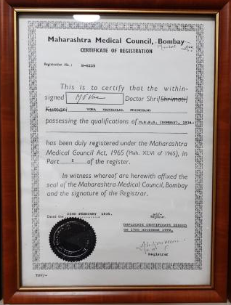
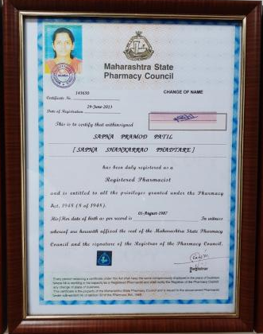
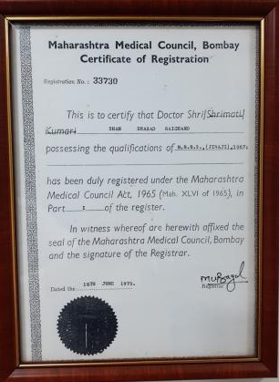
IN-HOUSE FACULTY

Slide 13
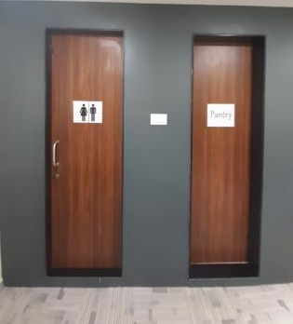
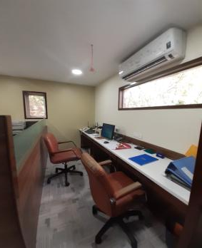
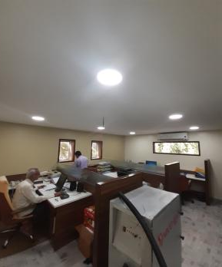
ADMINISTRATION OFFICE

Slide 14
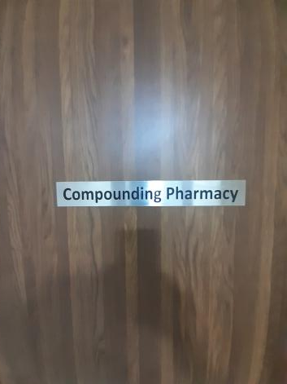
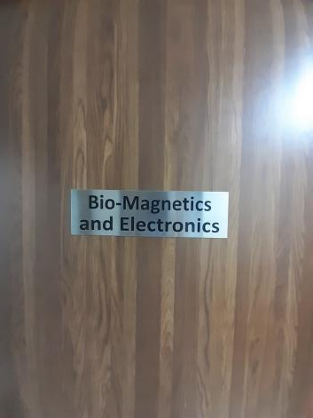
MEDICAL AND SCIENTIFIC FACILITIES

Slide 15
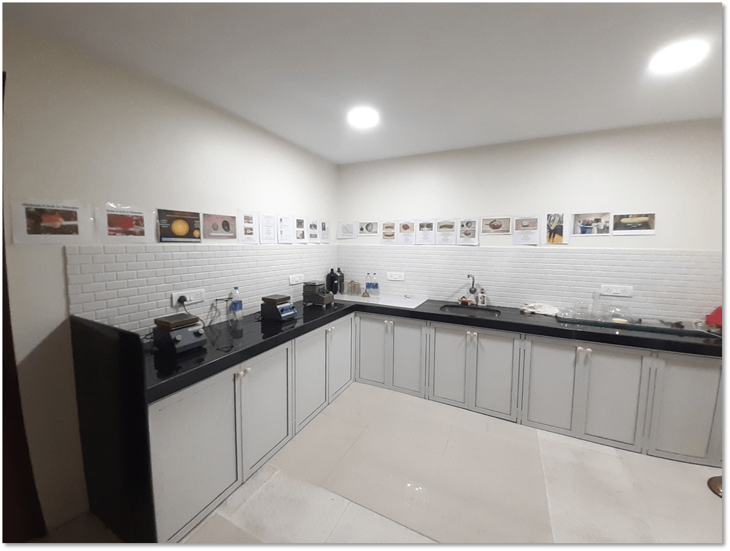
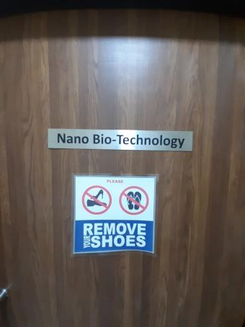
NANO BIO-TECHNOLOGY FACILITY
DEMO ROOM

Slide 16
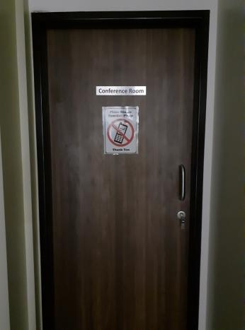
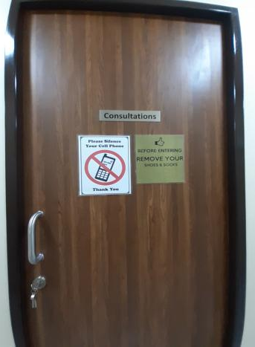
CONFERENCE ROOM
CONSULTATION ROOM

Slide 17
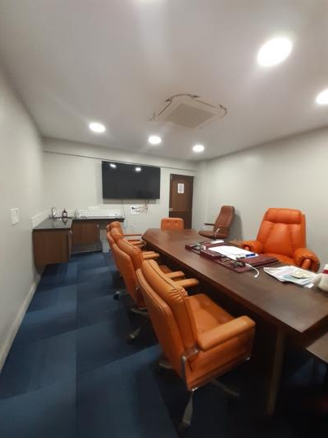
CONFERENCE ROOM

Slide 18
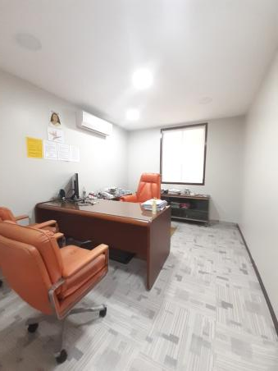
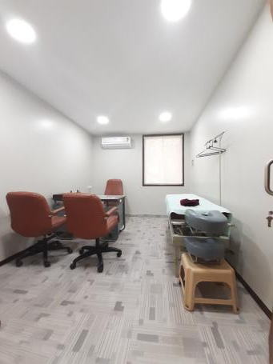
CONSULTATION ROOMS

Slide 19
AGRIMED
NUTRITIONAL FARMING

Slide 20
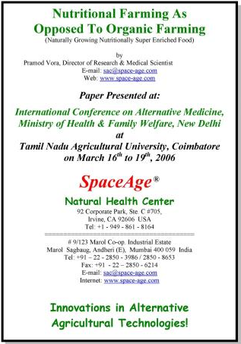
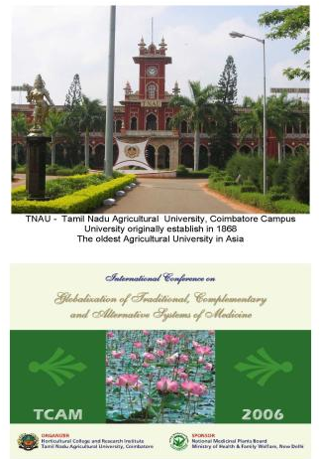

Slide 21
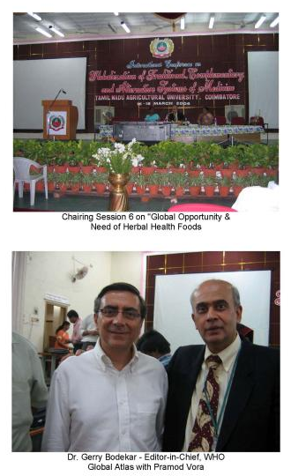
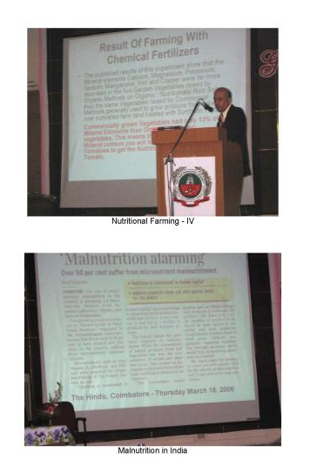

Slide 23
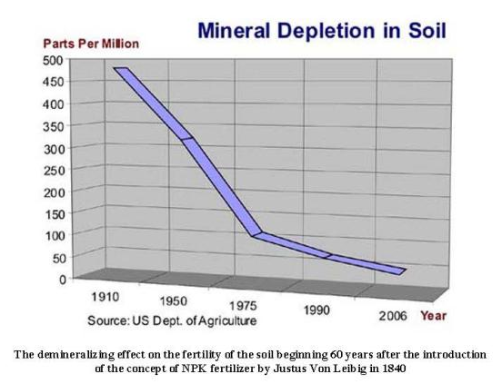

Slide 24
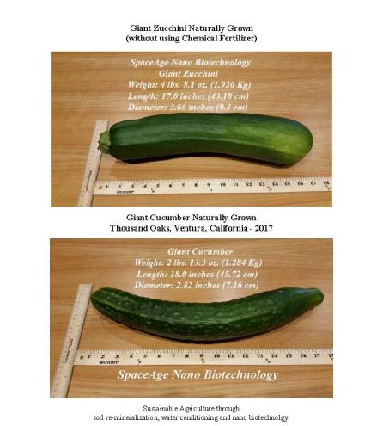
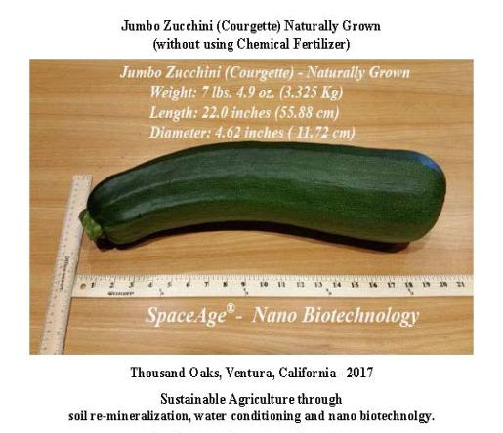

Slide 25
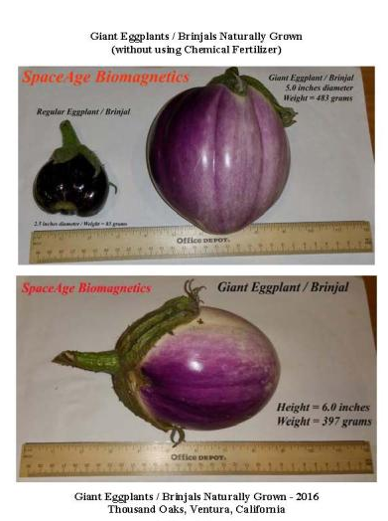
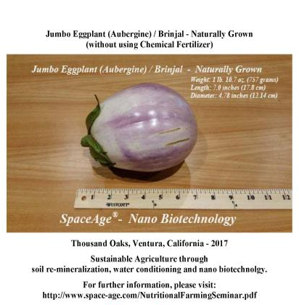

Slide 27
October 2018
Length: 28 inches
Circumference: 14 inches
Diameter: 4.46 inches
Weight: 8 lb 10.1 oz / 3.55 Kg

Slide 28
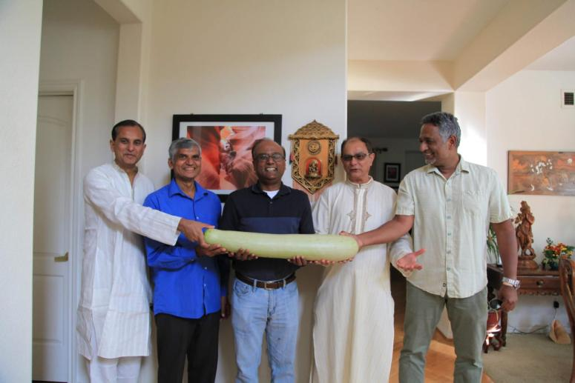
October 2019

Slide 29
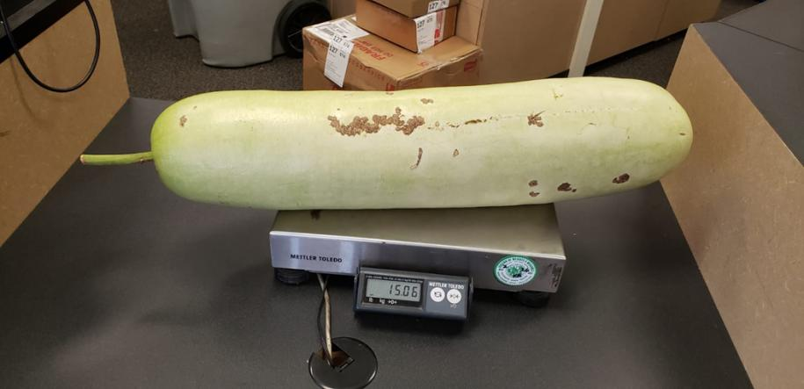
October 2020 - Weight: 15.06 lbs / 6.85 Kg

Slide 30
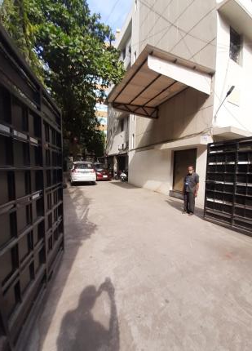
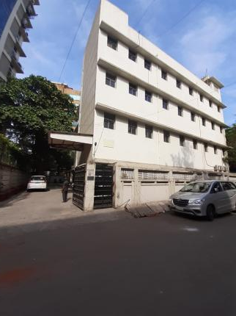
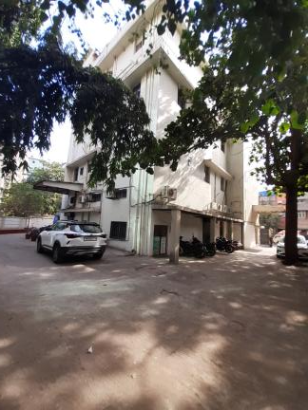
SPACE-AGE FACILITY BUILDING

Slide 31
SIAR SpaceAge Institute of Antiaging Research
92 Corporate Park, C #705 Irvine. CA 92606
Cell: +1 – 949 – 307 – 8801 E-mail: consult2008@space-age.com Zoom ID: 407 826 4641

