Slide 1
SIAR SpaceAge Institute of Antiaging Research

Slide 2
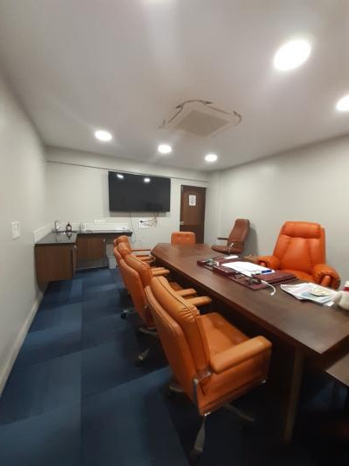
CONFERENCE ROOM

Slide 3
AGRIMED
NUTRITIONAL FARMING

Slide 4
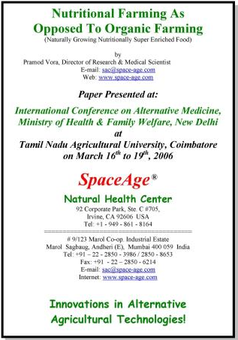
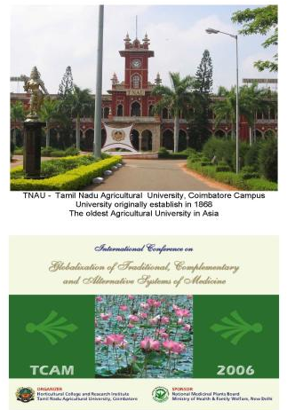

Slide 5
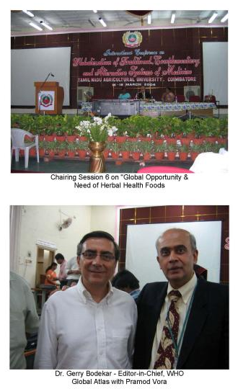
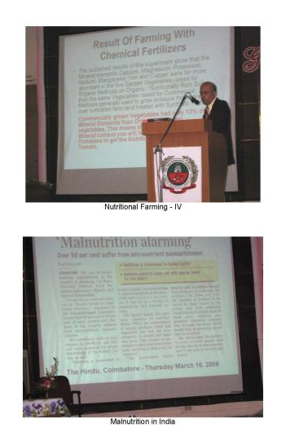

Slide 7
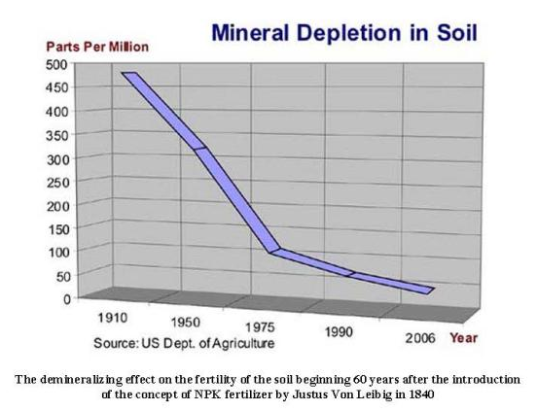

Slide 8
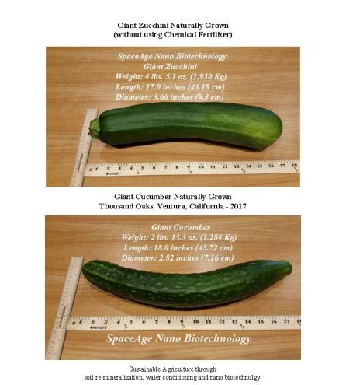
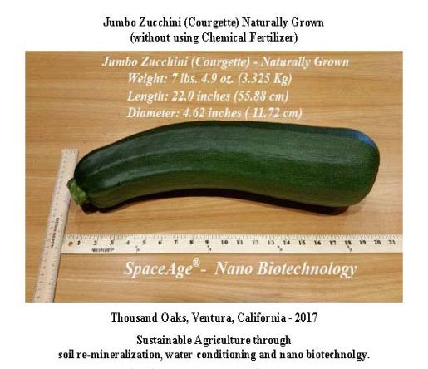

Slide 9
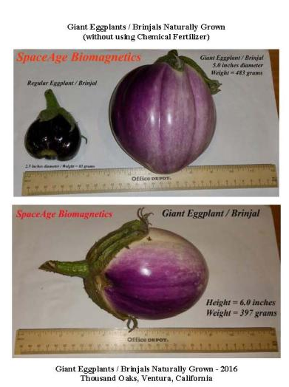
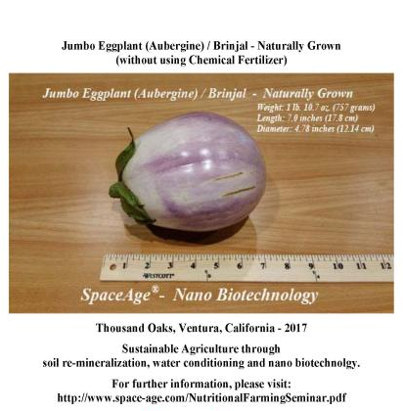

Slide 10
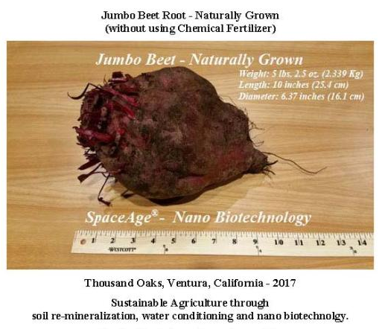

Slide 11
October 2018
Length: 28 inches
Circumference: 14 inches
Diameter: 4.46 inches
Weight: 8 lb 10.1 oz / 3.55 Kg

Slide 12
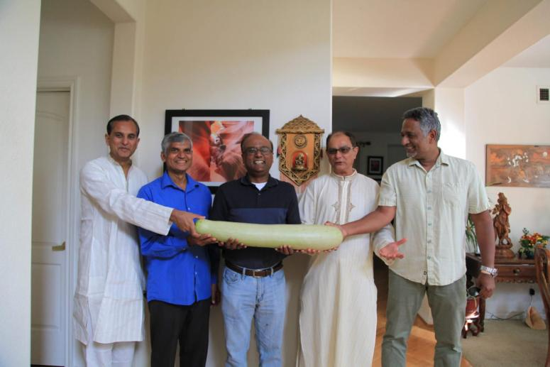
October 2019

Slide 13
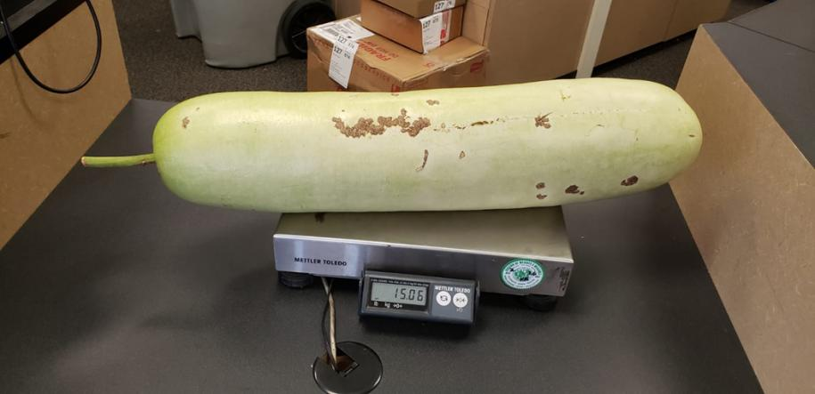
October 2020 - Weight: 15.06 lbs / 6.85 Kg

Slide 14
SIAR SpaceAge Institute of Antiaging Research
92 Corporate Park, C #705 Irvine. CA 92606
Cell: +1 – 949 – 307 – 8801 E-mail: consult2008@space-age.com Zoom ID: 407 826 4641

